Slide 1
WorkAbility 1 2020-21
Soft skills in the workplace:
Attitude, Verbal Communication and Customer Service

Slide 2
WorkAbility Program
14-22 Years-old in high school with current IEP
Career Counseling, Resume and Application assistance, Interview practice
Paid Work Experience – Pending COVID-19 reopening procedures and BCOE guidance for resuming student activities
10 Hour Special Projects for students age 14+
Up to 95 hours for students 16+
Referral services for the Department of Rehabilitation for additional paid work experience opportunities

Slide 3
Eligibility
Students must have the following:
Current IEP
Teacher Referral
90% Attendance within the last 30 days
Ability to get a work permit
Grades, attendance and disciplinary status may apply per school policy

Slide 4
How to Apply
Ask your teacher for a folder
Fill out the folder with your teacher or parent
An electronic version of the folder will be available this year, but there will still be several items that cannot be converted to digital and will require signatures.
Fill out all forms in pen!
There are forms that much be signed by you and your parent
Get applications from 3 businesses
Create a resume

Slide 5
How to Apply
You will also need the following documents, even if you worked last year:
Social Security Card or Birth Certificate
Photo ID (can use your school record provided by your teacher if you do not have one)

Slide 6
Placements
Once folder is complete, your job developer will meet with you to discuss a placement
You choose your top 3 choices for employment
If one of your choices is available, then an interview is set up.

Slide 7
Employers
We partner with many different employers in Butte County. These are just a few of the options:

Slide 8
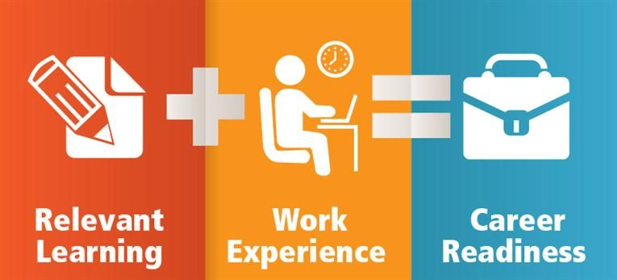
Soft Skills
Business partners will help to teach skills that will help with future employment through work experience
Even students that do not want to participate in a work experience or job shadow can schedule time with a job developer
Job developers can help with job applications, resumes, interview practice and any other career questions you may have
Job developers may come around to work on skills during class as teachers request

Slide 9
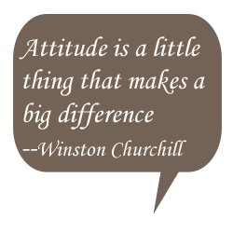
Soft Skills
Employments skills that are common to all jobs
Good Attitude
Teamwork
Problem Solving
Communication
Time Management
Customer Service
Professionalism
Listening

Slide 10
Customer Service
Successful businesses have good customer service
Two kinds of customers: internal and external
External customers – buy a service or product
Internal customers – support the production of the product or service
“Always treat your employees exactly as you want them to treat your best customer.” – Stephen Covey

Slide 11
Attitude
Employees with a positive attitude
Get along with coworkers
Recover quickly when things go wrong
Coachable
More receptive to change
More productive

Slide 12
Attitude
Asks “can I help you?”
Takes pride in their work
Is polite to everyone around
Tries to keep smiling
Upbeat and friendly
Doesn’t complain
Energetic and Enthusiastic

Slide 13
Communication
Small talk helps put people at ease and makes a positive impression
3 common starters for small talk:
Observation (It looks like it might rain today)
Question (What do you plan to do this weekend?)
Revelation (I’m looking forward to starting the school year)

Slide 14
WorkAbility 1
Folders are due no later than May 7, 2021
Need help or have questions:
Call 530-532-5922 or your job developer
Have a great school year!

